Slide 1

Hit Me or Hit Them
UTSA CS 3443 - 003
Spring 2020
MTM
Joseph D’Amico
Liz Nguyen
Jarrod Ragsdale
Tiffany T
Gage Nichols

Slide 2
Hit Me or Hit Them
Description
The Hit Me or Hit Them application is used for entertainment for single players only. The player has the choice of playing one of two card games, Blackjack or War.
Pitch
During the COVID-19 outbreak, stay inside and play some cards! Hit Me or Hit Them allows you to play Blackjack AND War with the computer for your entertainment during any isolative apocalyptic scenario. This is a great way to have some fun and practice healthy social distancing!
UTSA CS 3443 - 003
MTM- Hit Me or Hit Them

Slide 3
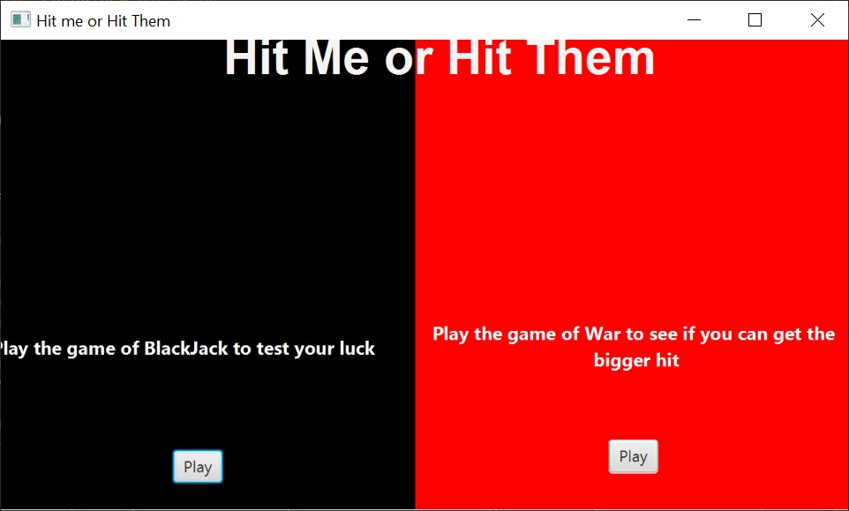
User Interface Design
Main Menu GUI
UTSA CS 3443 - 003
MTM – Hit Me or Hit Them

Slide 4
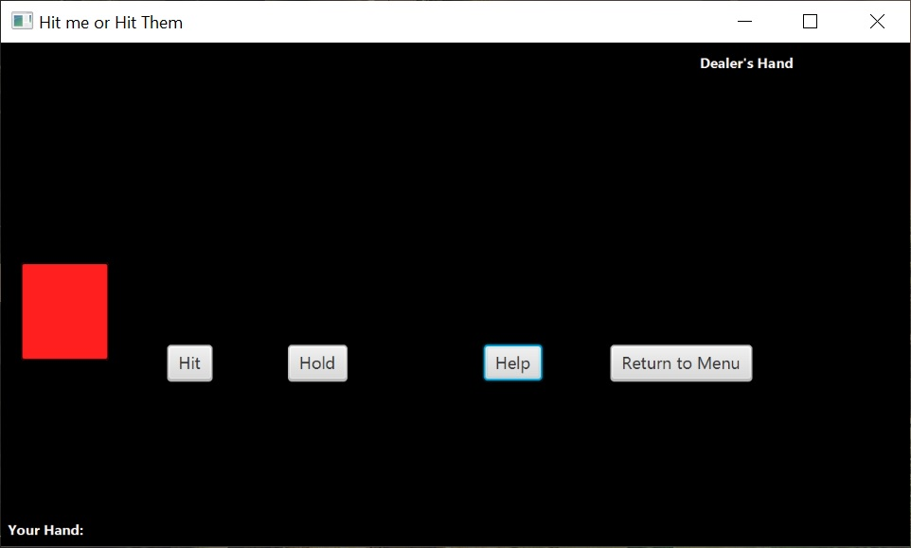
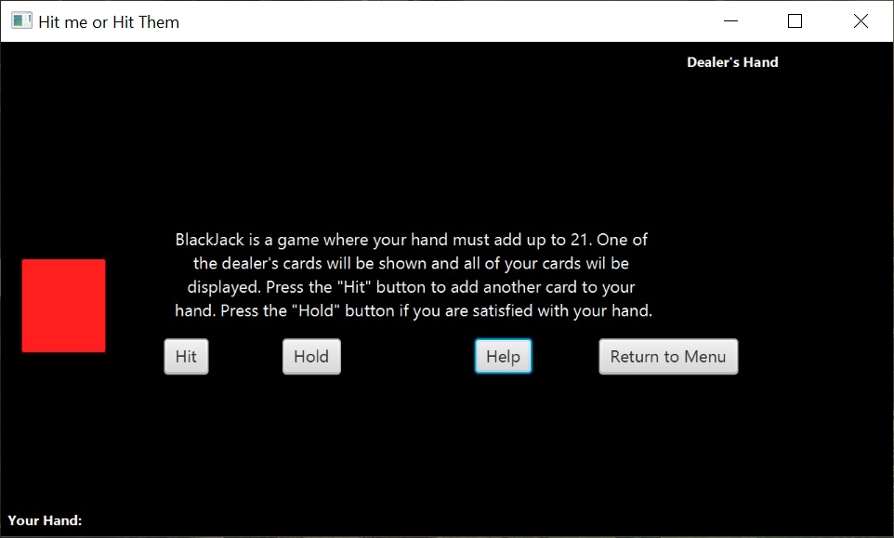
User Interface Design
Blackjack GUI
UTSA CS 3443 - 003
MTM – Hit Me or Hit Them

Slide 5
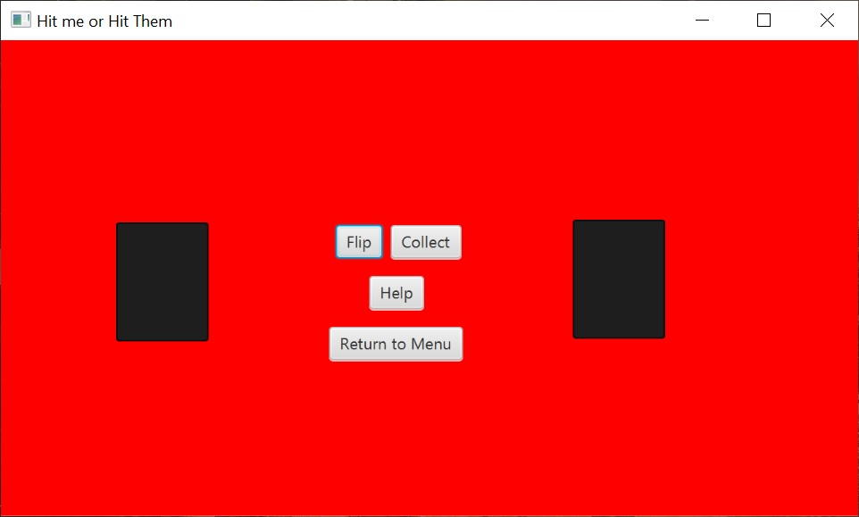
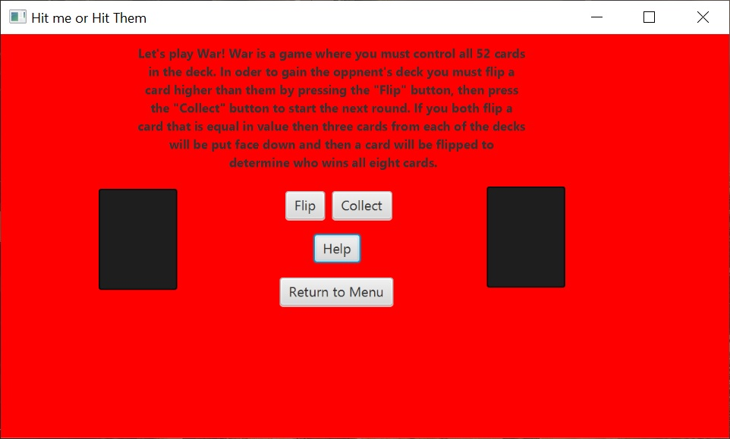
User Interface Design
War GUI
UTSA CS 3443 - 003
MTM – Hit Me or Hit Them

